Slide 1
ECE 313: PROBABILITY WITH ENGINEERING APPLICATIONS
Fall 2023
Prof. Eric Chitambar
Lecture 10

Slide 2






Negative Binomial Distribution

Slide 3



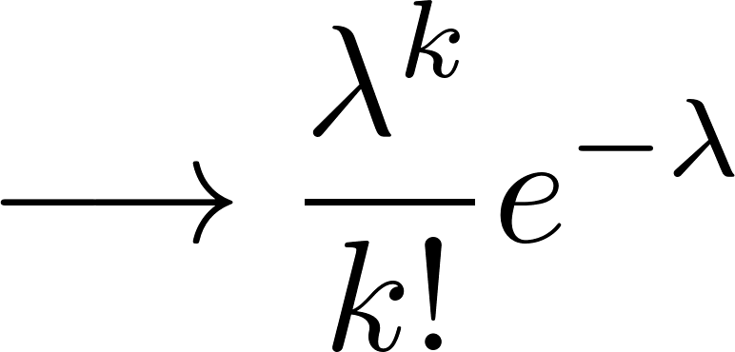
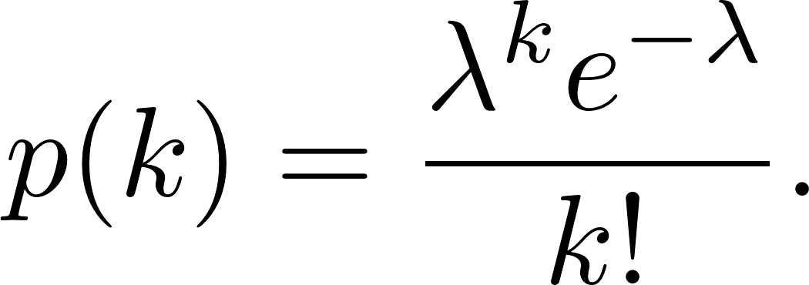
Poisson Distribution

Slide 4




Poisson Distribution

Slide 5
Example: Photon Counting

Slide 6
Maximum Likelihood Parameter Estimation

Slide 7

Maximum Likelihood Parameter Estimation

Slide 8

Maximum Likelihood Parameter Estimation

Slide 9
Maximum Likelihood Parameter Estimation

Slide 10


Markov’s Inequality

Slide 11




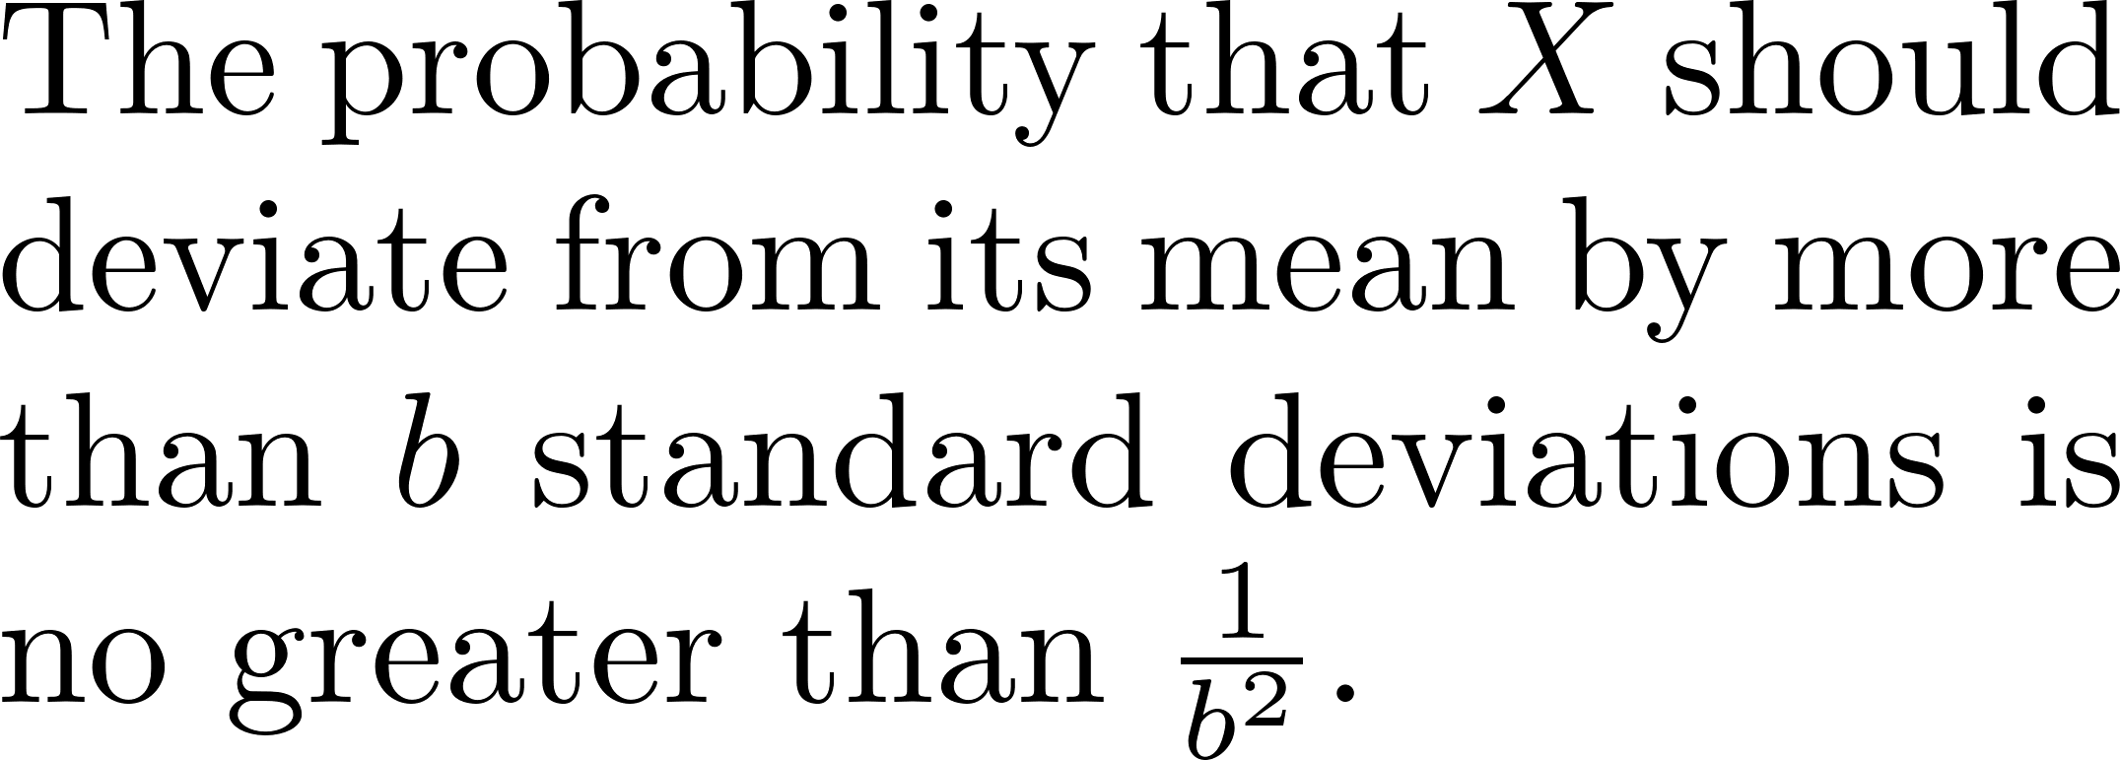
Chebyshev’s Inequality

